Slide 1
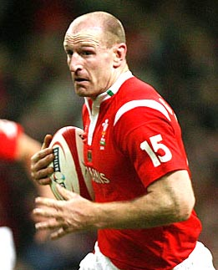
Gareth Thomas
Born 25 July 1974
Made 100 appearances and scored 40 tries for Wales
‘Came out’ as gay in 2009
“I'm proud of who I am. I feel I have achieved everything I could ever possibly have hoped to achieve out of rugby and I did it being gay. I want to send a positive message to other gay people that they can do it, too.“
“The boys (team mates)...have sat me down, one to one, and said: 'Mate, we've got so much time for what you've done. It's so brave, so powerful.‘
“When you can be 100 per cent honest with everyone, it makes you a better person, and a better player.”

Slide 2
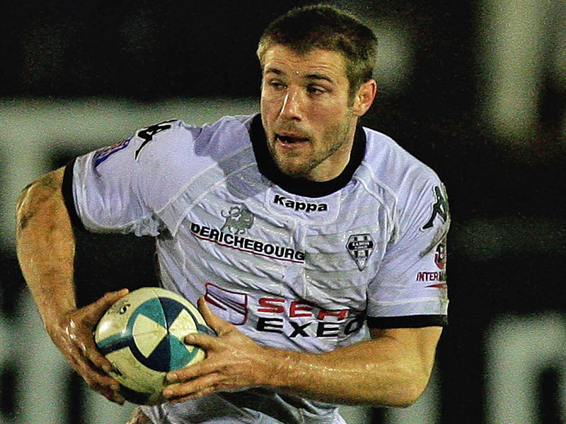
Ben Cohen
Born 14 September 1978
57 caps and 31 tries for England Runs the Stand Up Foundation against homophobic bullying
“I might be straight (heterosexual) but I can understand the mental scarring you can suffer from being bullied”
“When I played for a club I loved and I embraced my team mates, I found they brought the best out in me.....when you’re good enough to play it shouldn’t really matter what your sexual orientation is”

